Slide 1
Object Configurations: Salesforce Database and Views
What are objects
What are standard and custom objects and fields
How to create custom fields in std objects
How to create custom objects and custom fields
Field Data types and key properties(required,unique,foreign key)
Advanced data types (automatic validation,formatting)
UI:Page Configuring and creating page layout for objects
Set up history tracking for record updates on an object
Setting up chatter
Help reference:https://help.salesforce.com/articleView?err=1&id=getstart_help.htm&type=5

Slide 2
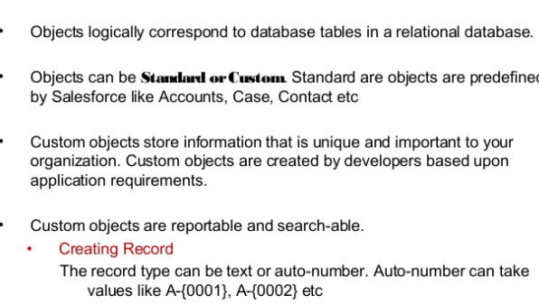
Object is a Table

Slide 3
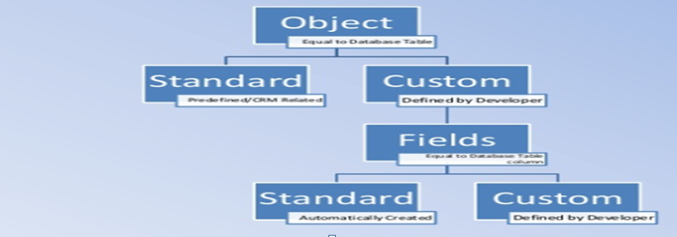
Objects And Fields

Slide 4
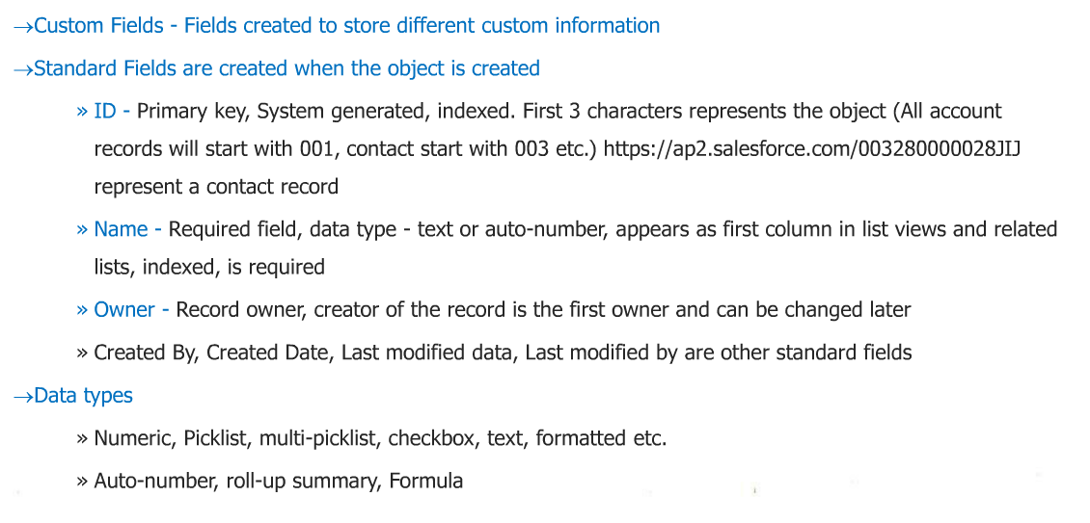
Field and Data Types

Slide 5
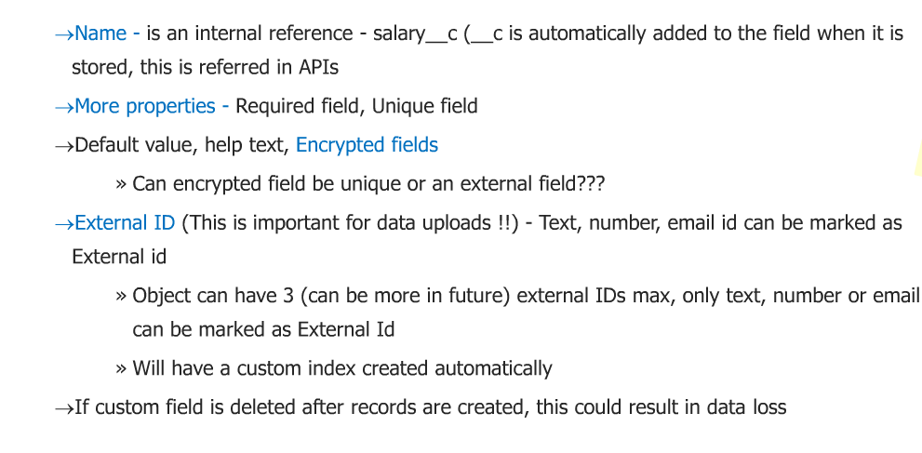
Fields and Data types

Slide 6
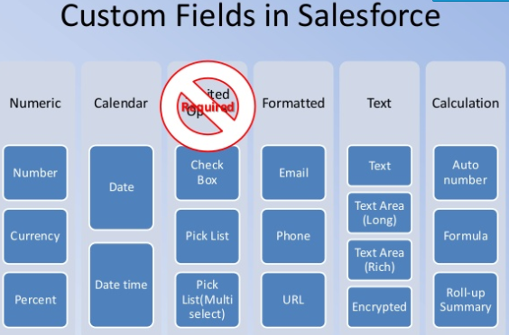
Data Types for Fields

Slide 7
Field Creation Process:Automatic layout and profile settings sidenote
When you create a new field, 2 things will keep appearing everytime during the process
Layouts to be added,Salesforce will automatically add the new fields to any existing layouts.
Which Profiles can see the fields, Profiles control what apps,tabs,crud access an object can have,we will look at profiles in security settings module

Slide 8
UI - Layouts

Slide 9
Layouts
Layouts are UI screens automatically created for each and every object that either exist or is created
Layouts hold fields,sections,buttons,
Layouts hold related list UI which shows related records to main object
Layout look and feel can be configured.
Layouts can be cloned to create new, and assigned to different record type and profile. So when user selects the record type,user will be presented with that particular record type layout.
Layouts data is saved,edited,deleted by underlying standard controller.

Slide 10
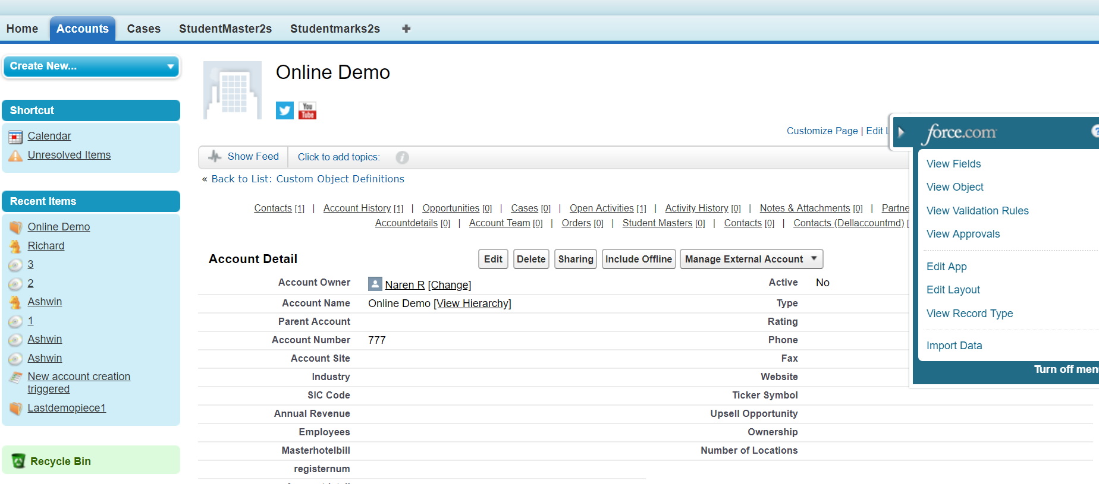
Edit page layouts
Navigate to a record and click the edit layout in the quick access menu

Slide 11
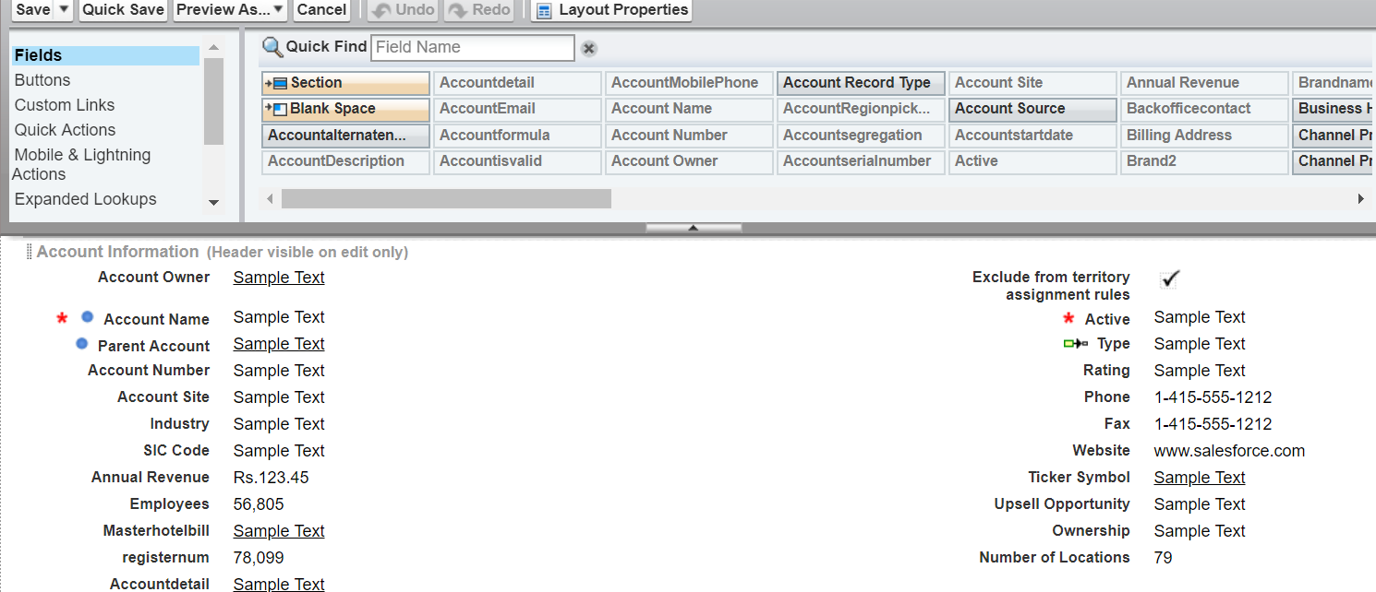
Format fields/sections/spaces
Click and drag fields in to the layout from the field sets

Slide 12
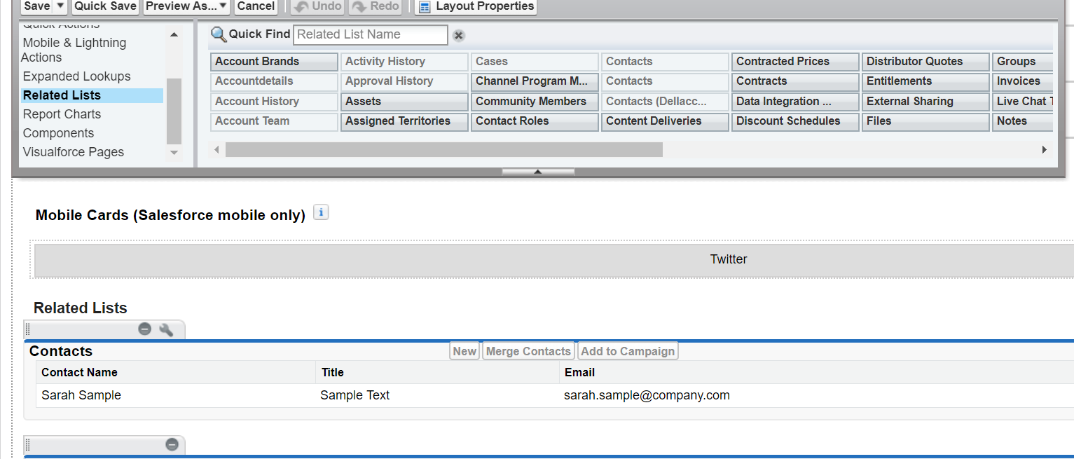
Configure the related lists if the object has MD or lookup relation

Slide 13
Labs
Create Custom app objects/Tabs/fields
Adding custom fields to standard objects
Create custom fields in account- revenuew,supportemail,phone,dependent picklist country/state,emcaccountnumber,servertypes,depending piclistregion countries
Create custom App Student Master
Create custom student master and marks objects
Create New App and add the tabs
List views and Page layouts for labs
Create criteria based list view
Create section in page layouts for the objects
Create Section in accounts layout – retail and wholesale
Configure type picklist for the record types-retail /wholesale
Create custom fields in account- revenuew,supportemail,phone,dependent picklist country/state,emcaccountnumber,servertypes,depending piclistregion countries
Setup field history tracking

Slide 14
Record type
Each object can have multiple record types
Each record type can be assigned to particular profile .
So user with the right profile can access the right record types.
Record type can be used to show particular layout or list of values
Profiles control what apps,layouts,object level access,we will look at profiles in detail in the security settings module.

Slide 15
Mapping record type to profile and layouts
We can multiple record types and create layout for each record type
Need to map record type to layout via user profiles
So if a profile has access to all the record types,the user will see the record type selection when user hits new button and will se corresponding layout
Lab:Actual implementation on accounts with retail and wholesale

Slide 16
Custom objects
Custom objects are created to fit in new business requirement .
It will contain the standard default fields
New fields can be added,layout will get automatically created
Please create student master and marks as part of project

Slide 17
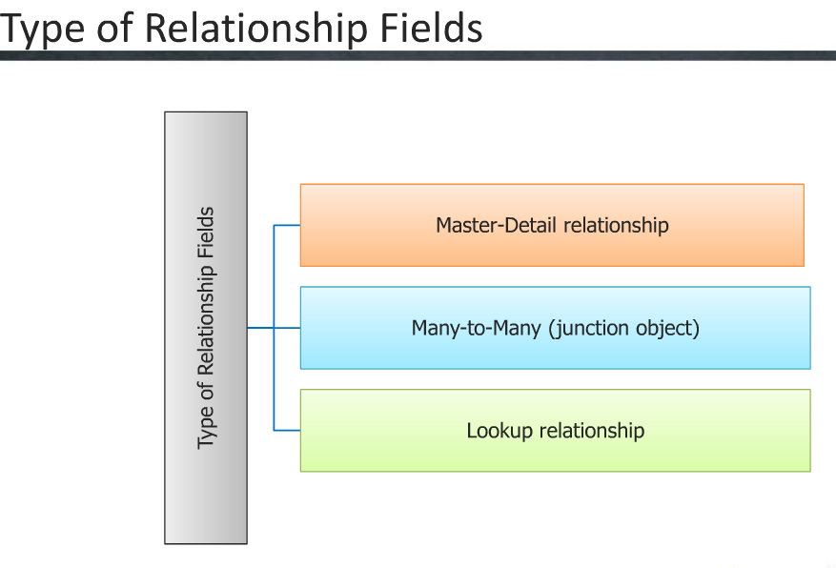

Slide 18
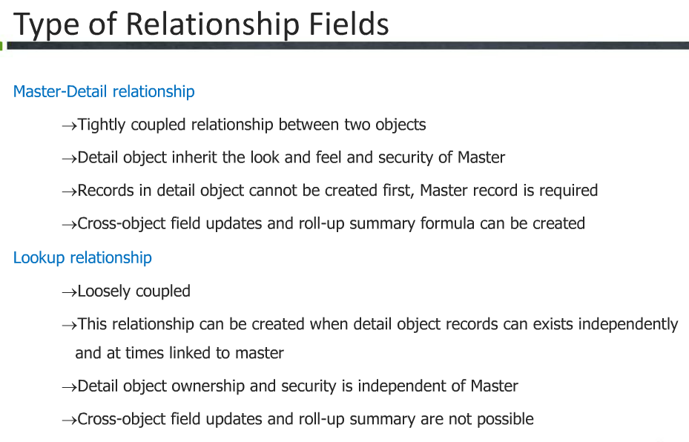

Slide 19
Self Relationships
A self Relationship is a lookup relationship to the same object.
For Example:-
User Object has a special type of lookup relationship: the hierarchy relationship. For example a hierarchy relationship allows developers to create a Manager field on the User object to relate another User.
Many to Many Relationships
We can achieve this type of relationships , by creating a junction object to connect 2 objects.
A junction object is a Custom object with 2 master-child relationships.

Slide 20
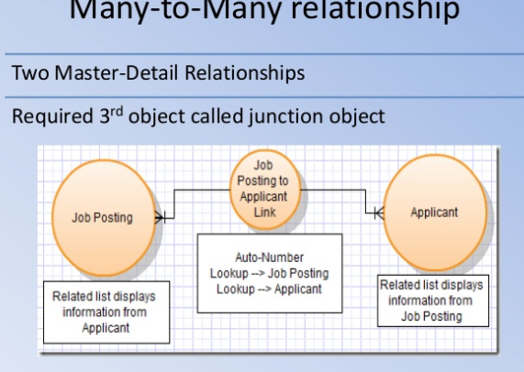

Slide 21
Field History tracking
Upto 20 fields can be tracked on each object using field history tracking,
Who ,when and what changes were made.
Helps with record level audit
Lab:Configure the layout to show tracking records in related list

Slide 22
Chatter usage
• Broadcast messages with high significance but low priority
• Peer recognition • HR updates
• Department or team KPIs and company-wide performance updates
• Industry or job-specific articles and videos that promote innovation
• Presentation slides
• Group voting and polls
• Which logo redesign do you like best?
• Idea generation
• What should we include in our meeting agenda?
• What problems are customers having we can solve?
• Asking non-urgent questions to other departments or subject matter experts
• Use the “knowledgeable people” feature to find people who can answer questions on specific topics
• Project team and committee updates, collaboration between meetings
• Questions and answers are searchable
• Post links or files relevant to topic
• Post updates to action items discussed during meetings
• Post files, status reports, questions and project updates

Slide 23
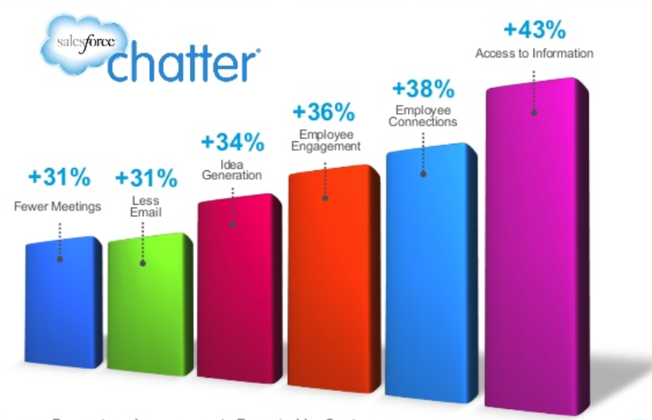
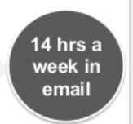
Benefits to companies

Slide 24
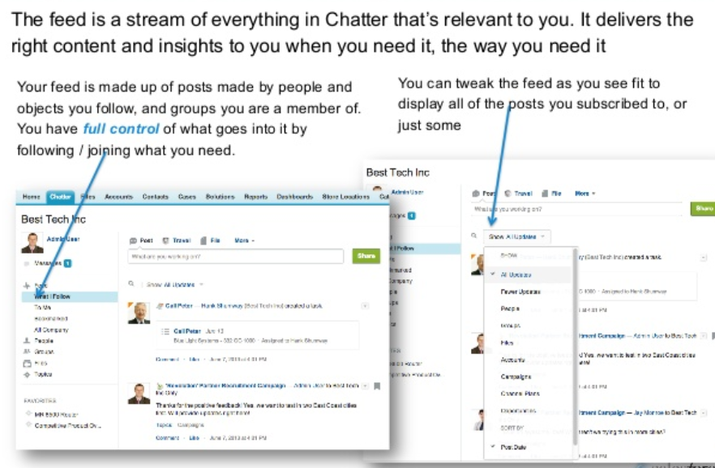
Chatter Feed

Slide 25
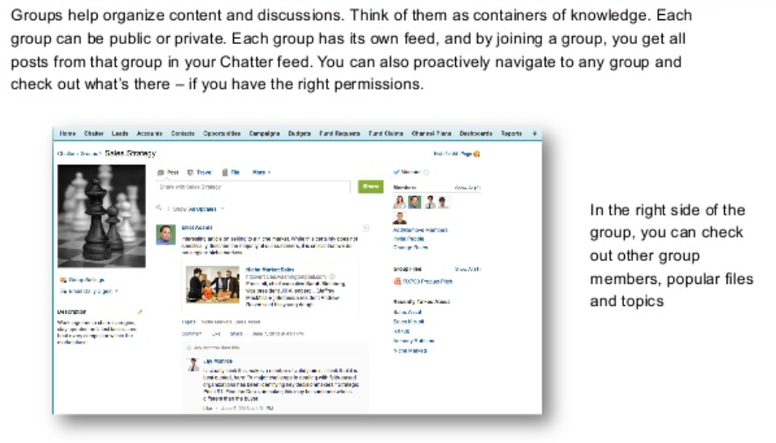
Chatter Groups

Slide 26
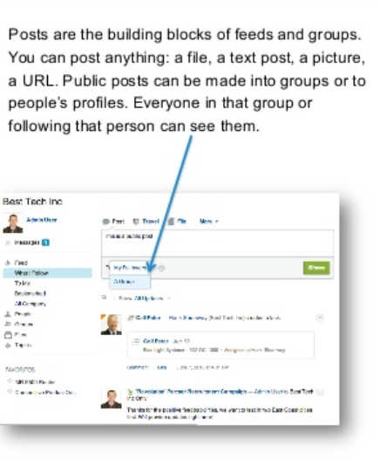
Chatter post

Slide 27
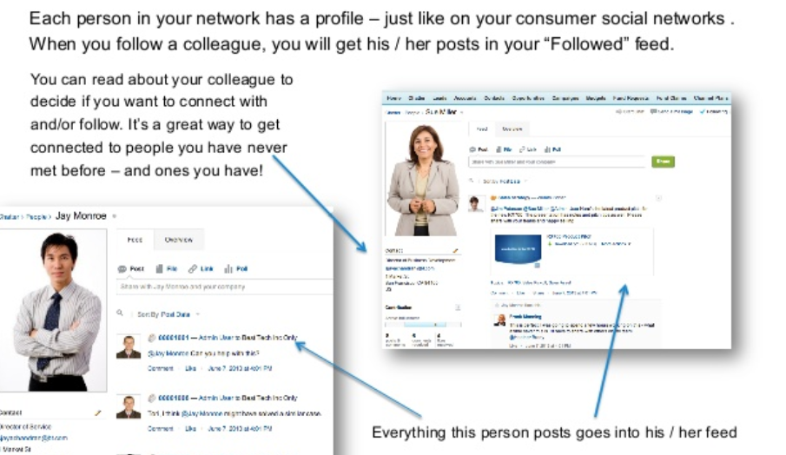
People and Profile

Slide 28
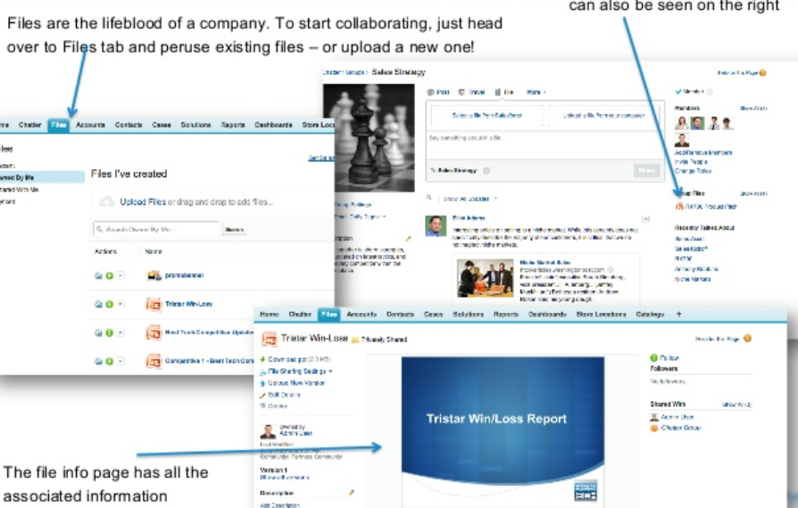
Chatter files

Slide 29
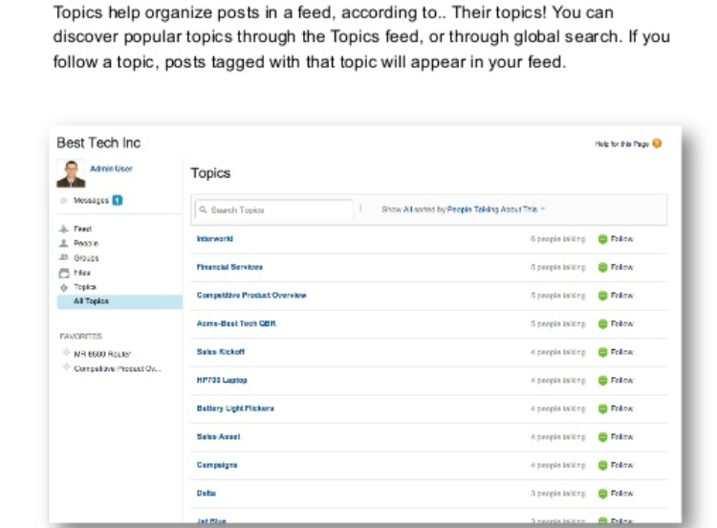
Topics

Slide 30
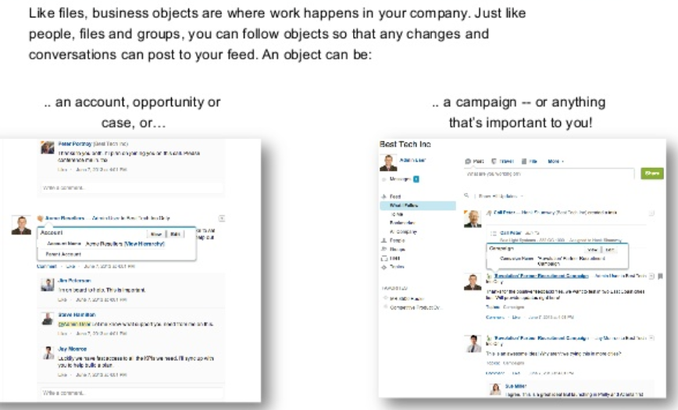
Object tracking with Chatter

Slide 31
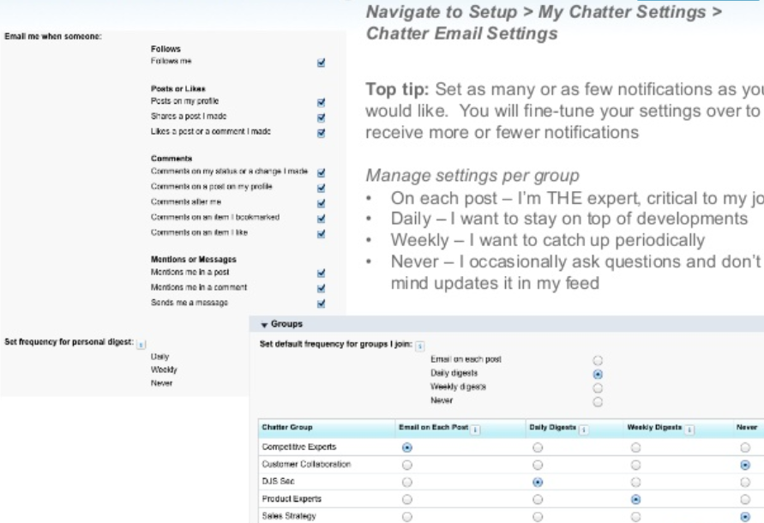
Email Settings 1

Slide 32
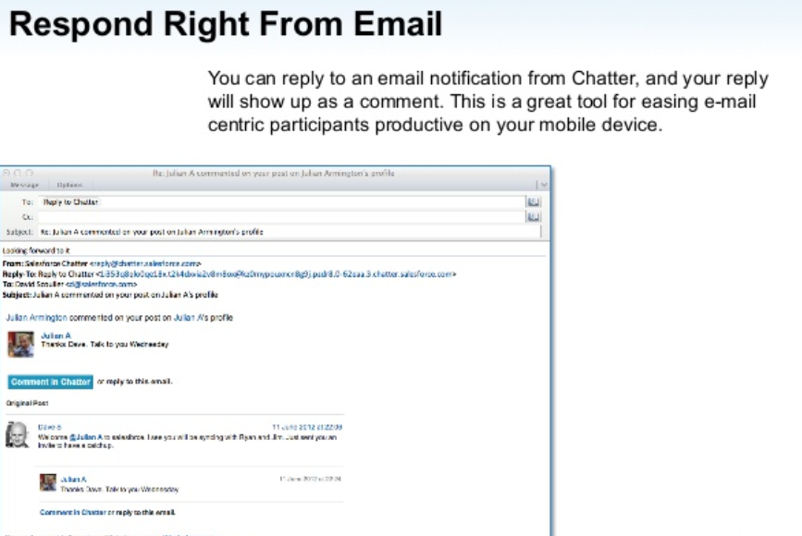
Email settings 2

Slide 33
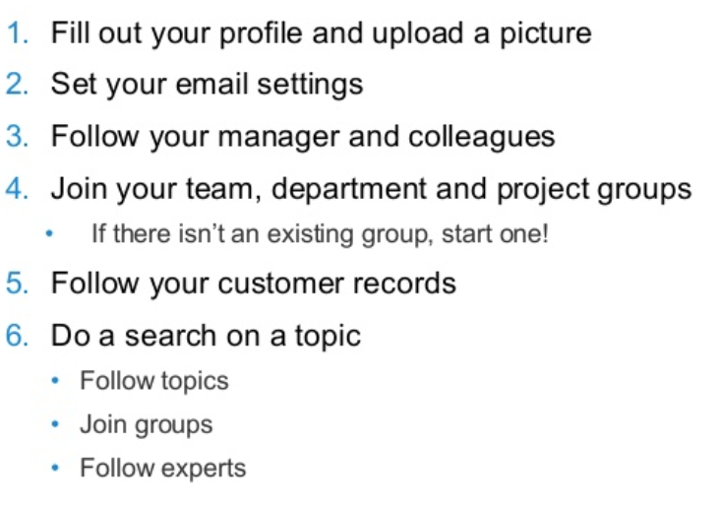
Lab

